Slide 1
Bidirectional Recurrent Neural Networks
CSCE 823 In-Class Lecture
2d Lt Nick Forrest

Slide 2
Overview
RNN review
Motivation
BRNNs defined
Architecture
Input/Outputs
Applications
Coding Demo

Slide 3
General RNN … A Review
Dynamic systems have a “state” which gets updated over time
The current state depends on the previous state and a transition function

Slide 4
Motivation
RNNs are notably order dependent.
Process input sequences in order
Does not see the “big picture”
Example:
I speak fluent ___________
because I lived in Japan for two years.
Japanese

Slide 5
Ensembling
Pooling together the predictions of a set of different models to produce better predictions
Different models are good for different reasons
Diversity is strength
Different models get part of the truth in the data, but not the whole truth
Many winners on Kaggle use ensembles of models
No single model can tell the entire truth of the data, but a combination of models can get fairly close
Notes:
Diversity is strength. If all of the models are biased in the same way, then the ensemble will retain the same bias. If all are bias in different ways, biases cancel each other out to create a more robust model. Example of blind men trying to describe an elephant.

Slide 6
BRNNs Defined
Advanced variation to RNN using ensembling
Increases accuracy and mitigates forgetting issues
Merger of two regular RNN models.
Chronological and antichronological input sequence
Often familiar RNNs like LSTM & GRU
ℎ_{𝑖} = 𝑞(ℎ_{𝑖}→ , ℎ_{𝑖}←)
Notes:
https://deepai.org/machine-learning-glossary-and-terms/bidirectional-recurrent-neural-networks
https://machinelearningmastery.com/develop-bidirectional-lstm-sequence-classification-python-keras/
“Unlike standard recurrent neural networks, BRNN’s are trained to predict both the positive and negative directions of time simultaneously. BRNN’s split the neurons of a regular RNN into two directions, one for the forward states (positive time direction), and another for the backward states (negative time direction) Neither of these output states are connected to inputs of the opposite directions. By employing two time directions simultaneously, input data from the past and future of the current time frame can be used to calculate the same output. Which is the opposite of standard recurrent networks that requires an extra layer for including future information.”

Slide 7
Architecture Overview
Notes:
http://colah.github.io/posts/2015-09-NN-Types-FP/

Slide 8
Training
Most commonly a supervised learning approach
It is difficult to calculate a reliable probabilistic model
Models are trained separately, then results are concatenated in final later
Twice as costly to train because there are twice as many parameters
Prone to quick overfitting
Notes:
https://deepai.org/machine-learning-glossary-and-terms/bidirectional-recurrent-neural-networks

Slide 9
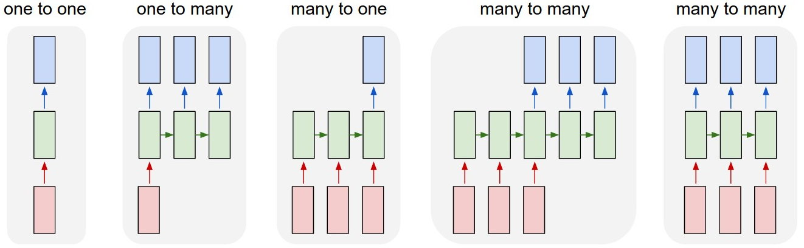
BRNN Input/Output Types
Red boxes are input (vectors)
Blue boxes are output (vectors)
Same as RNN models we have touched on
Notes:
http://karpathy.github.io/2015/05/21/rnn-effectiveness/
http://karpathy.github.io/assets/rnn/diags.jpeg

Slide 10
Merging Outputs
Outputs from each model are merged before being passed into output layer of the network
Concatenate individual output vectors
ℎ_{𝑖} = [ℎ_{𝑖}→ ; ℎ_{𝑖}←]
Sum individual outputs
Does not increase dimension
Loss of information
ℎ_{𝑖} = ℎ_{𝑖}→ + ℎ_{𝑖}←
Notes:
https://towardsdatascience.com/understanding-bidirectional-rnn-in-pytorch-5bd25a5dd66

Slide 11
Applications
Most beneficial in detecting patterns that may be overlooked by a unidirectional RNN
Useful for Natural Language Processing ☺
Order matters, but WHICH order is NOT crucial
Sentiment Analysis, feature extractions, digit classification
Poor performers on Sequence Data 😐
Recent past is much more important than the beginning of the sequence
Temperature prediction - relies heavily on chronological half

Slide 12
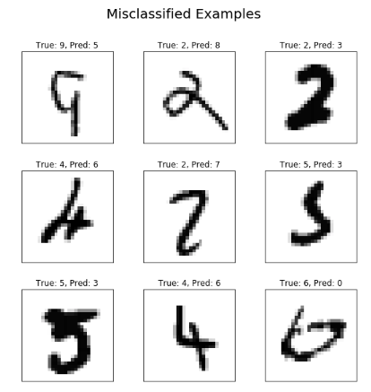
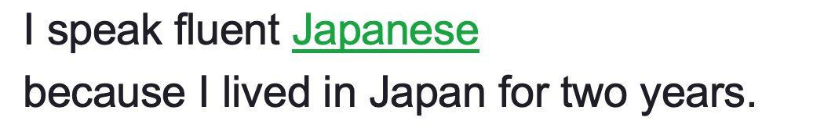
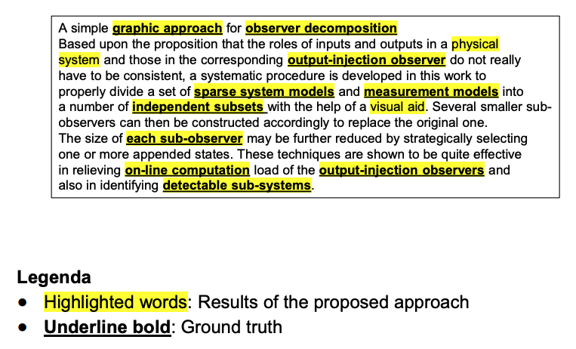
Applications
Notes:
What are the different applications or times to actually use these?
Digit classification - http://www.easy-tensorflow.com/tf-tutorials/recurrent-neural-networks/bidirectional-rnn-for-classification
Key phrase extraction - http://ircdl2018.dimi.uniud.it/wp-content/uploads/2018/02/Keyphrase_LSTM_IRCDL.pdf
Speech Recognition - https://machinelearningmastery.com/develop-bidirectional-lstm-sequence-classification-python-keras/

Slide 13
Questions?

Slide 14
Demo
Simple sequence classification problem in Keras
Inputs order sensitive sequences of events
Outputs classification for sequence
Evaluated compared to randomly generated sequences
Chronological order LSTM RNN vs.
Antichronological Order LSTM RNN vs.
Bidirectional LSTM RNN
Compares different model merging modes
Notes:
This slide is left up during the demo, general overview of what’s going on in the demo

